Slide 1
Chapter 12: Mass-Storage Systems

Slide 2
Chapter 12: Mass-Storage Systems
Overview of Mass Storage Structure(大容量存储器结构简介)
Disk Structure(磁盘结构)
Disk Attachment(磁盘附属)
Disk Scheduling(磁盘调度)
Disk Management(磁盘管理)
Swap-Space Management(交换空间管理)
RAID Structure(RAID结构)
Stable-Storage Implementation
Tertiary Storage Devices
Operating System Issues
Performance Issues

Slide 3
Objectives
Describe the physical structure of secondary and tertiary storage devices and the effect of a device’s structure on its uses
Explain the performance characteristics of mass-storage devices
Evaluate I/O scheduling algorithms
Discuss operating-system services provided for mass storage, including RAID

Slide 4
12.1 Overview of Mass Storage Structure
大容量存储器结构简介
hard disk drives (HDDs) 硬盘与 nonvolatile memory (NVM) 固态存储为现代计算机系统提供了大容量的二级存储
HDDs(硬盘) 的盘片一般是铝制的，表面涂敷了磁性材料及保护层，高速旋转，经过读写磁头下方
盘片旋转速度一般在60-250转/秒，也就是3600-15000转/分
Transfer rate(传输速率) 是指在驱动器与计算机之间的数据传输率
Positioning time(定位时间) (random-access time， 随机访问时间) 由两部分组成：
1-把磁臂移动到所需柱面的seek time(寻道时间)
2-等待所需扇区旋转到磁头下的rotational latency(旋转等待时间) ，取决于盘片转速，平均为半圈
Head crash(磁头碰撞) 磁头与盘片表面物理接触，可能会破坏磁盘表面，产生坏道
可移动磁盘

Slide 5
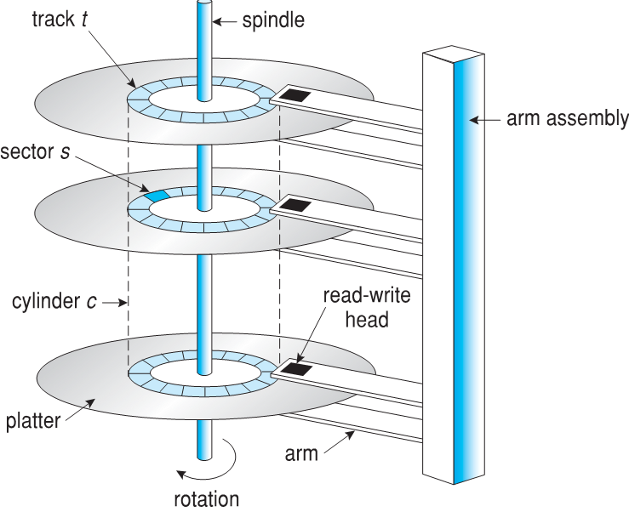
Moving-head Disk Mechanism

Slide 6
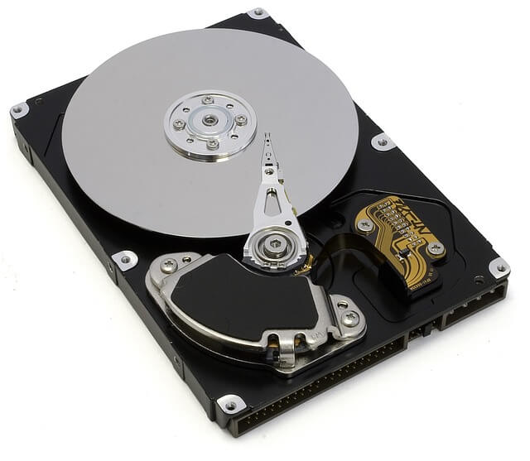
Hard Disk Drives(硬盘驱动器)
Platters range from .85” to 14” (historically)
Commonly 3.5”, 2.5”, and 1.8”
Range from 30GB to 1xTB per drive
Performance
Transfer Rate – theoretical – 6 Gb/sec
Effective Transfer Rate – real – 1Gb/sec
Seek time from 3ms to 12ms – 9ms common for desktop drives
Average seek time measured or calculated based on 1/3 of tracks
Latency based on spindle speed
1 / (RPM / 60) = 60 / RPM
Average latency = ½ latency

Slide 7
*Hard Disk Performance(硬盘性能)
Access Latency = Average access time = average seek time + average latency
For fastest disk 3ms + 2ms = 5ms
For slow disk 9ms + 5.56ms = 14.56ms
Average I/O time = average access time + (amount to transfer / transfer rate) + controller overhead
For example to transfer a 4KB block on a 7200 RPM disk with a 5ms average seek time, 1Gb/sec transfer rate with a .1ms controller overhead =
5ms + 4.17ms + 0.1ms + transfer time =
Transfer time = 4096 * 8/ 10⁹ = 0.033 ms
Average I/O time for 4KB block = 9.27ms + 0.033ms = 9.303ms

Slide 8
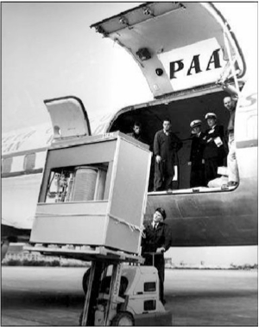
*The First Commercial Disk Drive
1956
IBM RAMDAC computer included the IBM Model 350 disk storage system
5M (7 bit) characters
50 x 24” platters
Access time = < 1 second

Slide 9
*Nonvolatile Memory Devices
If disk-drive like, then called solid-state disks (SSDs)
Other forms include USB drives (thumb drive, flash drive), DRAM disk replacements, surface-mounted on motherboards, and main storage in devices like smartphones
Can be more reliable than HDDs
More expensive per MB
Maybe have shorter life span – need careful management
Less capacity
But much faster
Busses can be too slow -> connect directly to PCI for example
No moving parts, so no seek time or rotational latency

Slide 10
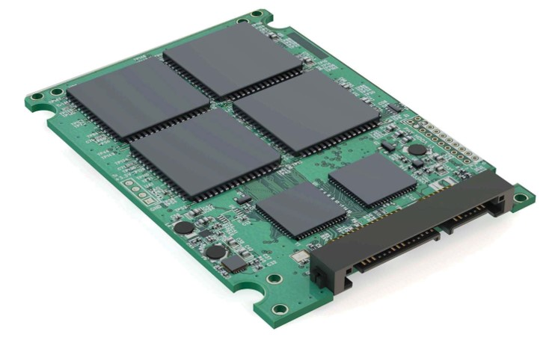
*Nonvolatile Memory Devices
Have characteristics that present challenges
Read and written in “page” increments (think sector) but can’t overwrite in place
Must first be erased, and erases happen in larger ”block” increments
Can only be erased a limited number of times before worn out – ~ 100,000
Life span measured in drive writes per day (DWPD)
A 1TB NAND drive with rating of 5DWPD is expected to have 5TB per day written within warrantee period without failing

Slide 11
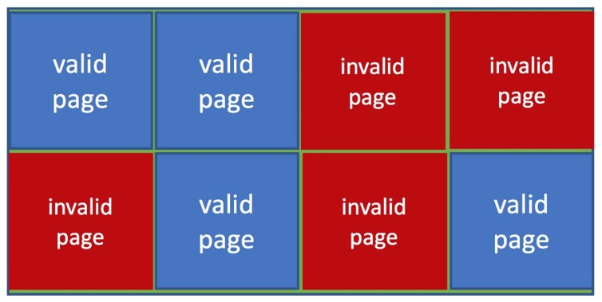
*NAND Flash Controller Algorithms
With no overwrite, pages end up with mix of valid and invalid data
To track which logical blocks are valid, controller maintains flash translation layer (FTL) table
Also implements garbage collection to free invalid page space
Allocates overprovisioning to provide working space for GC
Each cell has lifespan, so wear leveling needed to write equally to all cells
NAND block with valid and invalid pages

Slide 12
*Volatile Memory
DRAM frequently used as mass-storage device
Not technically secondary storage because volatile, but can have file systems, be used like very fast secondary storage
RAM drives (with many names, including RAM disks) present as raw block devices, commonly file system formatted
Computers have buffering, caching via RAM, so why RAM drives?
Caches / buffers allocated / managed by programmer, operating system, hardware
RAM drives under user control
Found in all major operating systems
Linux /dev/ram, macOS diskutil to create them, Linux /tmp of file system type tmpfs
Used as high speed temporary storage
Programs could share bulk date, quickly, by reading/writing to RAM drive

Slide 13
Magnetic Tape(磁带)
早期的二级存储介质
相对说来能长期存储，且容量大
访问速度慢
随机访问时间大约是磁盘的1000倍量级
常用来作为数据备份，存储不经常使用的数据，或在不同系统间拷贝数据
磁带绕在卷轴上，向前或向后转，并经过磁头
一旦磁头到位，传输速率可与磁盘相比
典型的几十GB至几十TB容量
有4mm, 8mm, 19mm, LTO-2, SDLT等不同规格

Slide 14
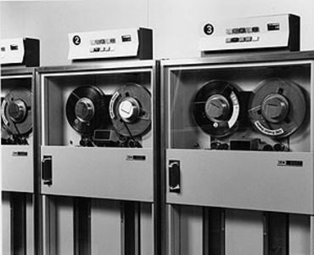
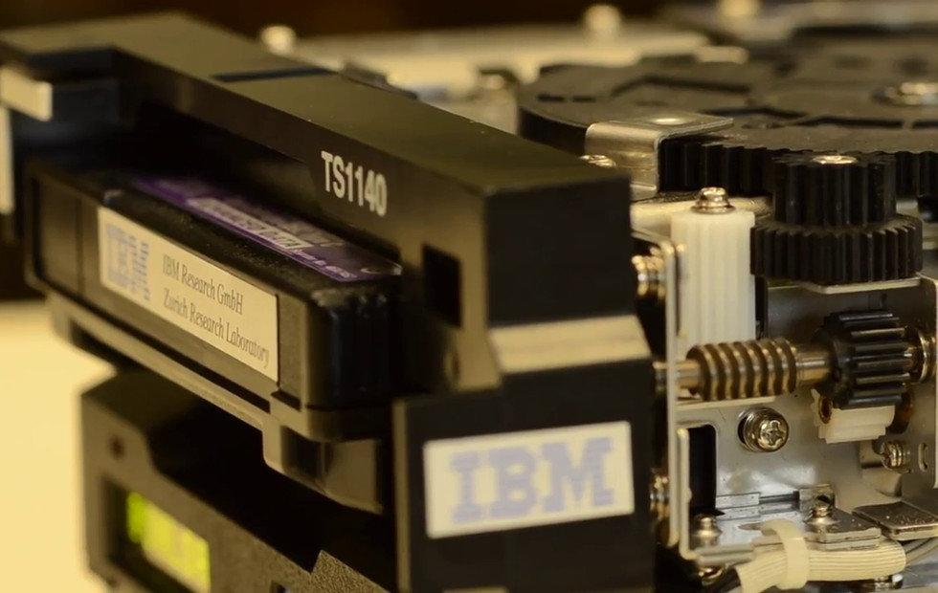
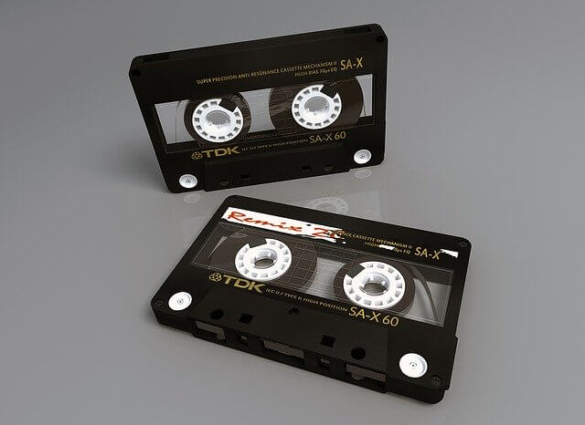
Sony, IBM develop a 330 TB magnetic tape storage -2017

Slide 15
12.2 Disk Structure(磁盘结构)
磁盘驱动器可看作一个一维的logical blocks(逻辑块)数组，逻辑块为最小的传输单位
通过低级格式化在物理介质上创建logical blocks(逻辑块)，现代磁盘一般为预先低级格式化好的
一维逻辑块数组按顺序映射到磁盘的扇区
扇区0是最外柱面的第一个磁道(磁头)的第一个扇区
映射顺序(指逻辑块号递增)是先按磁道内扇区顺序，再按柱面内磁道顺序(磁头顺序)，最后是由外至内的柱面顺序
逻辑地址到物理地址转换比较简单
坏扇(又称坏道，因为常常连续若干个扇区损坏)问题，需要替换坏扇区
对常量线性速度(constant linear velocity, CLV)磁盘，在不同的柱面，其单个磁道内的扇区数是不同的，外围柱面的磁道包含更多扇区
Notes:
恒定圆角速度(constant angular velocity, CAV)，在不同的柱面，旋转速度(RPM)保持不变。意味着内圈的磁道上，位密度比较大(沿磁道圆周方向上，单位长度上含有的位数比较多)

Slide 16
12.3 Storage Attachment(磁盘附属)
计算机以三种方式访问外部存储
主机附属
网络附属
云存储

Slide 17
Storage Attachment(主机附属存储)
主机附属通过本地的I/O端口访问，使用的技术包括
SCSI是一种外设总线，电缆上可挂接16台设备，SCSI引导器(initiator)发出指令，SCSI目标(target)接收并执行指令
每个SCSI目标(target)有访问8个逻辑单元的能力(磁盘挂接在设备控制器上)
可以通过USB, firewire, thunderbolt 来挂接许多设备
高端系统采用fibre channel (FC，光纤通道)
高速串行架构，采用光纤或铜缆
多个主机，多个存储设备可以连接到光纤通道

Slide 18
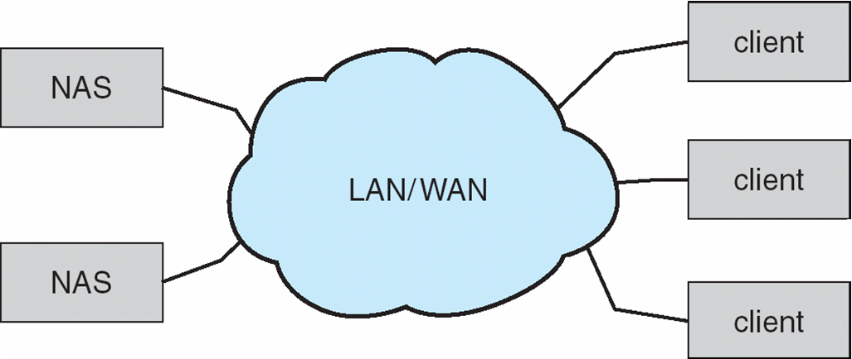
Network-Attached Storage(网络附属存储)
Network-attached storage (NAS，网络附属存储) 是通过网络，而非本地连接(比如总线)访问的存储系统
通过远程进程调用来融入文件系统
NFS 与 CIFS 是常用的协议
通过IP网络，在主机与存储设备间基于TCP或UDP网络协议之上的远程进程调用 (RPCs) 实现
iSCSI 协议利用IP网络来远程传输SCSI协议
在远端连接到存储设备(块)

Slide 19
*Cloud Storage(云存储)
Similar to NAS, provides access to storage across a network
Unlike NAS, accessed over the Internet or a WAN to remote data center
NAS presented as just another file system, while cloud storage is API based, with programs using the APIs to provide access
Examples include Dropbox, Amazon S3, Microsoft OneDrive, Apple iCloud
Use APIs because of latency and failure scenarios (NAS protocols wouldn’t work well)

Slide 20
*Storage Array(存储阵列)
Can just attach disks, or arrays of disks
Avoids the NAS drawback of using network bandwidth
Storage Array has controller(s), provides features to attached host(s)
Ports to connect hosts to array
Memory, controlling software (sometimes NVRAM, etc)
A few to thousands of disks
RAID, hot spares, hot swap (discussed later)
Shared storage -> more efficiency
Features found in some file systems
Snaphots, clones, thin provisioning, replication, deduplication, etc

Slide 21
Storage Area Network(存储区域网络)
常见于大型存储环境。采用私有网络(专用存储协议，而非网络协议)
多台主机连接到多个存储阵列，灵活性高

Slide 22
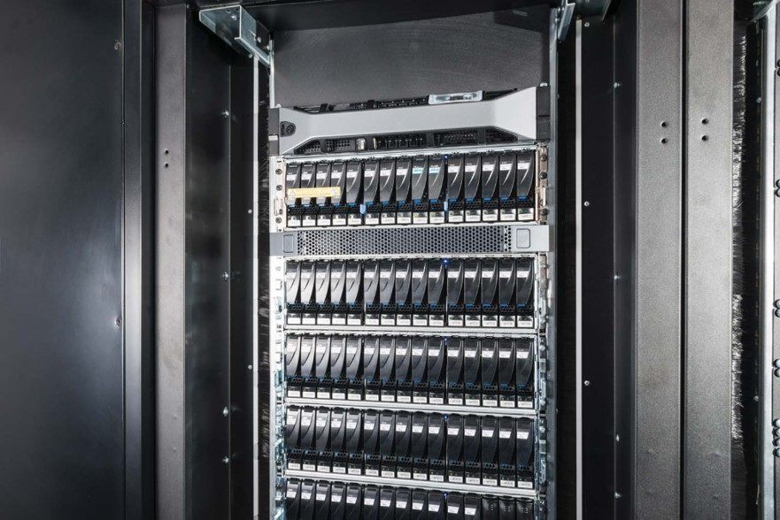
*Storage Area Network (Cont.)
SAN is one or more storage arrays
Connected to one or more Fibre Channel switches or InfiniBand (IB) network
Hosts also attach to the switches
Storage made available via LUN Masking from specific arrays to specific servers
Easy to add or remove storage, add new host and allocate it storage
Why have separate storage networks and communications networks?
Consider iSCSI, FCOE
A Storage Array

Slide 23
12.4 Disk Scheduling(磁盘调度)
操作系统的任务之一就是有效地使用硬件，对于磁盘驱动器，这意味着达到快速访问及总的磁盘传输带宽，最小的寻道时间(Minimize seek time)
对于磁盘，寻道时间基本上正比于寻道距离(从当前柱面把磁臂移动到目的柱面，为两个柱面号的差值)
磁盘带宽(bandwidth)是所传输的总字节数，除以从服务请求开始，到完成最后传输的时间

Slide 24
Disk Scheduling (Cont.)
磁盘I/O请求有很多来源
OS
系统进程
用户进程
I/O请求包括是读还是写模式，磁盘地址，内存地址，传输的扇区
OS为每一个磁盘或设备维护一个请求队列

Slide 25
Disk Scheduling (Cont.)
空闲的磁盘可以马上响应I/O请求，忙时就需要把任务排队
算法优化仅对需要排队时有用
在过去，操作系统需要管理任务队列，对磁盘进行调度
但现在(今天是2021年6月)，这些功能已集成进存储设备，或控制器了
现代的磁盘，已把柱面、磁头、扇区的物理地址隐藏在内部
主机仅仅提供LBA(Logical Block Address,逻辑区块地址)，以及为请求排序

Slide 26
Disk Scheduling (Cont.)
注意磁盘控制器内包含小的缓冲区，用于管理I/O请求队列(可变长度)
存在数种调度磁盘I/O请求的算法
算法对一个或多个盘片均适用
在下面的调度算法中，我们假设磁盘柱面号为0-199
磁盘请求队列为(柱面号)： 98, 183, 37, 122, 14, 124, 65, 67
初始时磁头位于53号柱面

Slide 27
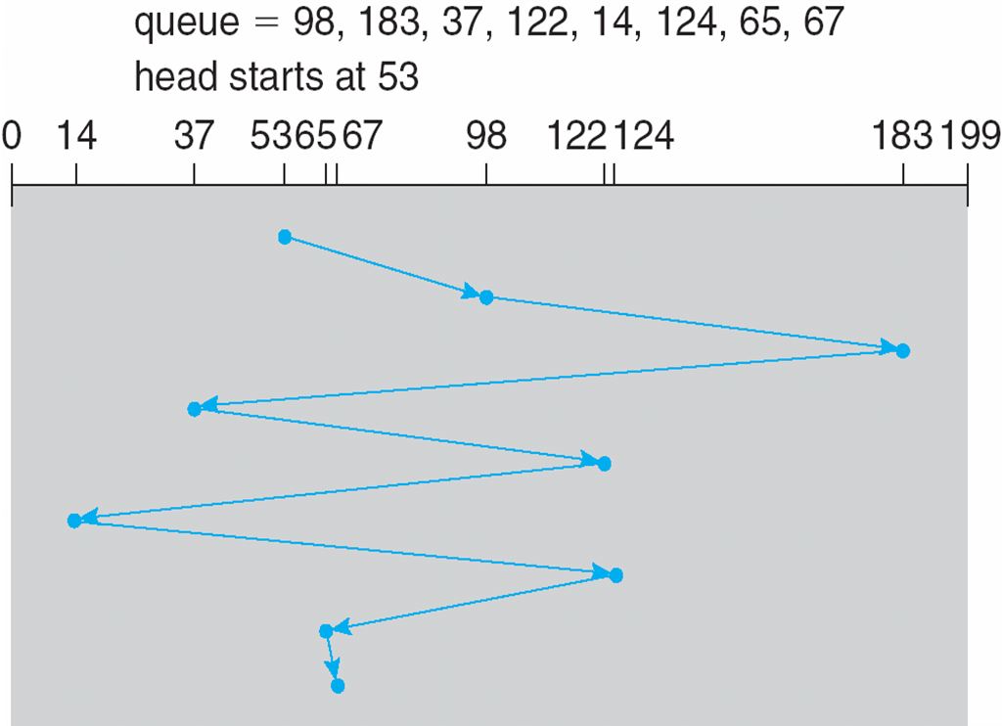
FCFS(First-Come First-Served 先来先服务调度)
按请求的顺序，依次进行访问。总的磁头移动为640柱面

Slide 28
SSTF(Shortest Seek Time First 最短寻道时间优先)
最短寻道时间优先总是从当前磁头位置，寻找寻道时间最短的请求处理
SSTF 调度是一种最短任务优先算法(SJF)，可能造成一些请求饥饿
请求顺序：98, 183, 37, 122, 14, 124, 65, 67
调度顺序：(53), 65, 67, 37, 14, 98, 122, 124, 183
总的磁头移动为236个柱面数
(67-53) + (67-14) + (183-14) = 236
是一种贪心算法

Slide 29
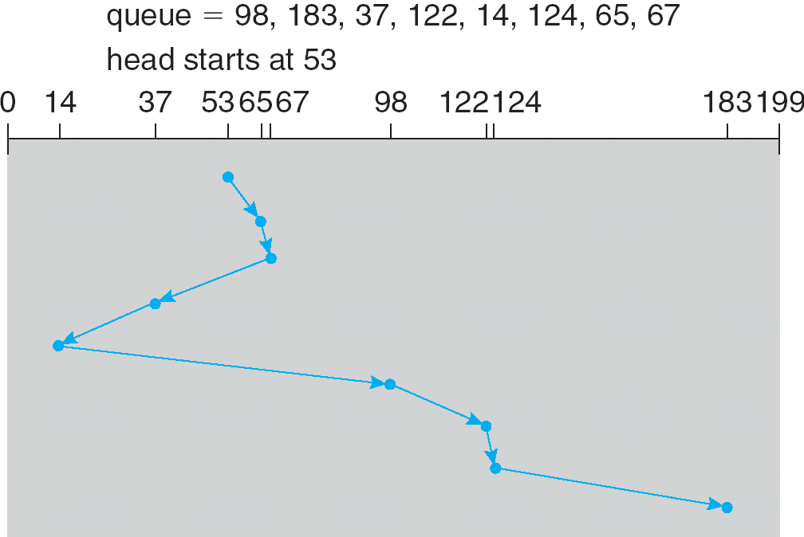
SSTF Scheduling (Cont.)

Slide 30
SSTF Scheduling (Cont.)
SSTF较之FCFS有更好的寻道性能，一度被广泛采用过
磁臂粘着，造成饥饿
不能保证平均寻道时间最短 (not optimal)
请求队列：98, 183, 37, 122, 14, 124, 65, 67
SSTF调度顺序：53,65,67,37,14,98,122,124,183
如果调度顺序改为：53,37,14,65,67,98,122,124,183
总的磁头移动柱面数为208，好于SSTF的236
(53-14)+(183-14)=208

Slide 31
SCAN
磁臂从磁盘的一端开始，在磁盘柱面的两个端点(最小及最大柱面号)之间，来回移动，当磁头在某个请求的柱面上方时，就处理该请求
SCAN algorithm有时也成为elevator algorithm(电梯算法)
总的磁头移动柱面数为(假设一开始磁头向柱面小的方向移动)
53 + 183 = 236(在柱面0处折返)
注：OSC7-10官方PPT给出的数据是208，这应该是在柱面14处折返的数据，也就是后面讲的LOOK算法的数据
假设磁盘请求均匀分布在各个柱面上，则靠近两个端点柱面的请求，其平均等待时间大于磁盘中间的请求

Slide 32
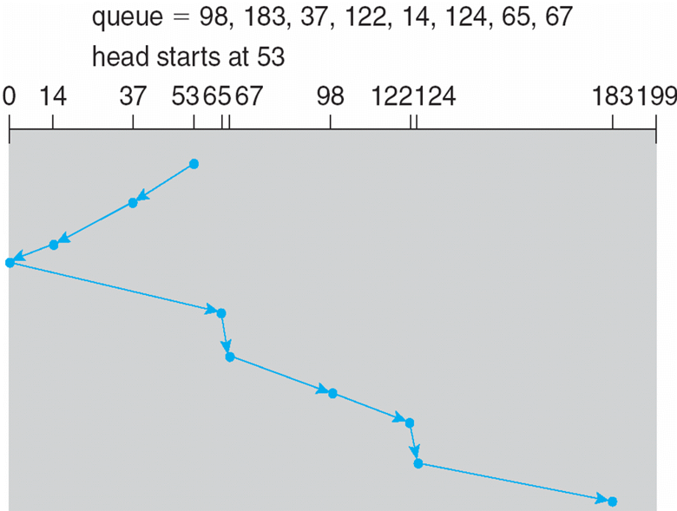
SCAN (Cont.)

Slide 33
C-SCAN(Circular-SCAN)
提供了比SCAN更均匀的等待时间
磁头从磁盘的一个端点，移动到另一个端点，并在此过程中，若磁头在某个请求的柱面上方时，就处理该请求
到达另一个端点时，立即折返，且在折返的过程中，不处理任何请求
也就是仅在磁头移动的一个方向时处理请求，另一个移动反向总是不处理请求
基本上，C-SCAN将柱面当成一个环链，将最后一个柱面与第一个柱面相连

Slide 34
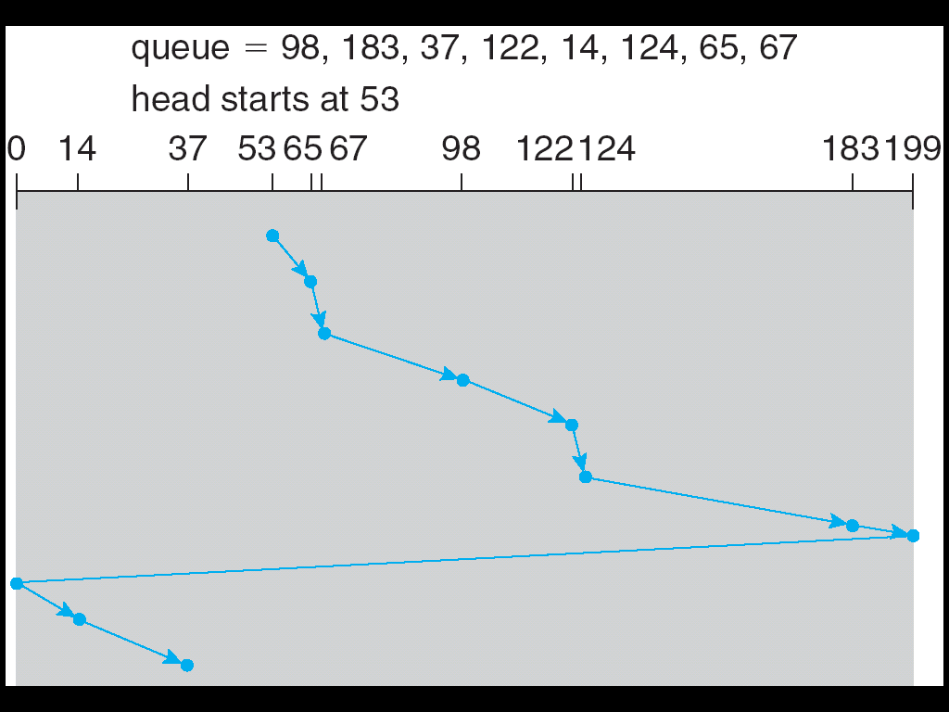
C-SCAN (Cont.)

Slide 35
LOOK Scheduling(LOOK与C-LOOK调度)
分别为 SCAN 和 C-SCAN算法的变化
磁头仅移动至当前方向上的最后一个请求，而不是一定要达到末端
SCAN → Look
C-SCAN → C-Look

Slide 36
LOOK Scheduling

Slide 37
LOOK Scheduling(LOOK调度)
与SCAN 相比，提高了效率
当前磁头位置: 53
假设磁头当前移动方向：0
请求队列: 98, 183, 37, 122, 14, 124, 65, 67
调度顺序为：53,37,14,65,67,98,122,124,183
总的磁头移动柱面数：
(53-14)+(183-14)=208

Slide 38
C-LOOK Scheduling(C-LOOK调度)
C-SCAN的变化
假定磁盘的最外道号为 199，最内道号为 0
当前磁头位置: 53
假设磁头当前移动方向：199
请求队列: 98, 183, 37, 122, 14, 124, 65, 67
调度顺序是：53,65,67,98,122,124,183,14,37
总的磁头移动柱面数：
(183-53) + (183-14) + (37-14) = 322

Slide 39
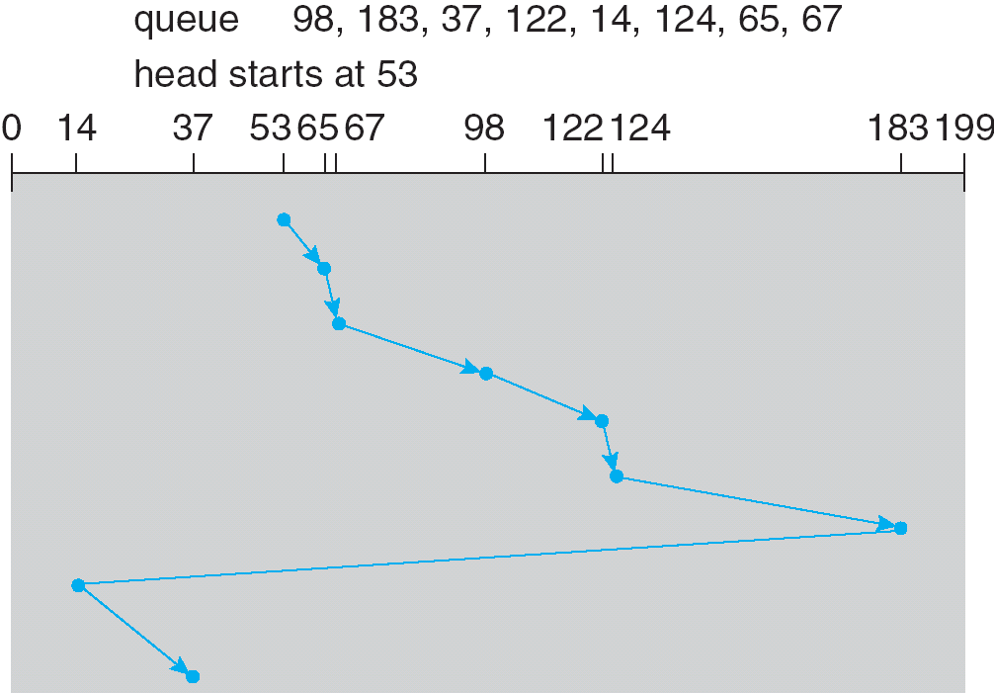
C-LOOK Scheduling (Cont.)

Slide 40
Selecting a Disk-Scheduling Algorithm
磁盘调度算法的选择
SSTF较为普通且很有吸引力
SCAN 与 C-SCAN 对高负荷的系统，性能比较好
没有SSTF那样的饥饿问题，但高负荷时有的任务可能延迟很大
LOOK也是比较合理的选择
现代磁盘，旋转等待几乎与平均寻道时间一样。但磁盘通常不透露当前磁头处于哪个扇区的信息，OS即便得到了这样的信息，相对于寻道，调度扇区也更困难。因为磁盘在工作时一直在旋转中，调度扇区的实时性要求很强

Slide 41
*Selecting a Disk-Scheduling Algorithm
To avoid starvation Linux implements deadline scheduler
Maintains separate read and write queues, gives read priority
Because processes more likely to block on read than write
Implements four queues: 2 x read and 2 x write
1 read and 1 write queue sorted in LBA order, essentially implementing C-SCAN
1 read and 1 write queue sorted in FCFS order
All I/O requests sent in batch sorted in that queue’s order
After each batch, checks if any requests in FCFS older than configured age (default 500ms)
If so, LBA queue containing that request is selected for next batch of I/O

Slide 42
*NVM Scheduling
No disk heads or rotational latency but still room for optimization
In RHEL 7 NOOP (no scheduling) is used but adjacent LBA requests are combined
NVM best at random I/O, HDD at sequential
Throughput can be similar
Input/Output operations per second (IOPS) much higher with NVM (hundreds of thousands vs hundreds)
But write amplification (one write, causing garbage collection and many read/writes) can decrease the performance advantage

Slide 43
12.5 Storage Device Management(磁盘管理)
Low-level formatting(低级格式化), or physical formatting(物理格式化) 将磁盘划分为扇区，使得磁盘控制器能够读写
每个扇区有头部信息，数据区，及纠错编码 (error correction code, ECC)
通常数据区长度为512字节，但近年来磁盘的物理扇区一般为4096字节
为了用磁盘保存文件，操作系统需要将自己的数据结构记录在磁盘上
Partition(分区) 将磁盘分为若干个逻辑磁盘，每个逻辑盘都包含一些连续柱面
Logical formatting(逻辑格式化) 或者称为 “生成一个文件系统”
为了提高性能，大多数文件系统把若干连续块聚合成蔟(clusters)
磁盘I/O通过块完成
文件I/O通过蔟完成

Slide 44
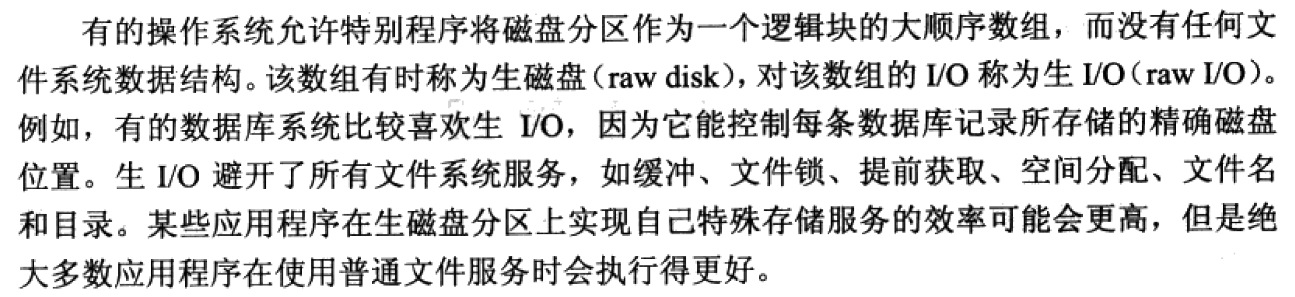
Raw Disk

Slide 45
Storage Device Management (cont.)
Boot Block(引导块) 包含操作系统，其他分区可包含另外的操作系统，其他的文件系统，或者raw(生磁盘)
在启动时安装
其他分区可以自动安装，或者手动安装
在安装时，检查文件系统的完整性
所有元数据是否正确？
如果不正确，修复，并重新检查
如果正确，增加到已安装表，允许访问该文件系统
引导块可以指向引导卷，或者包含引导程序的多个块，从而能够运行足够长的代码，将OS内核从文件系统调入内存
或者是用一个引导管理程序，来进行多OS的引导过程

Slide 46
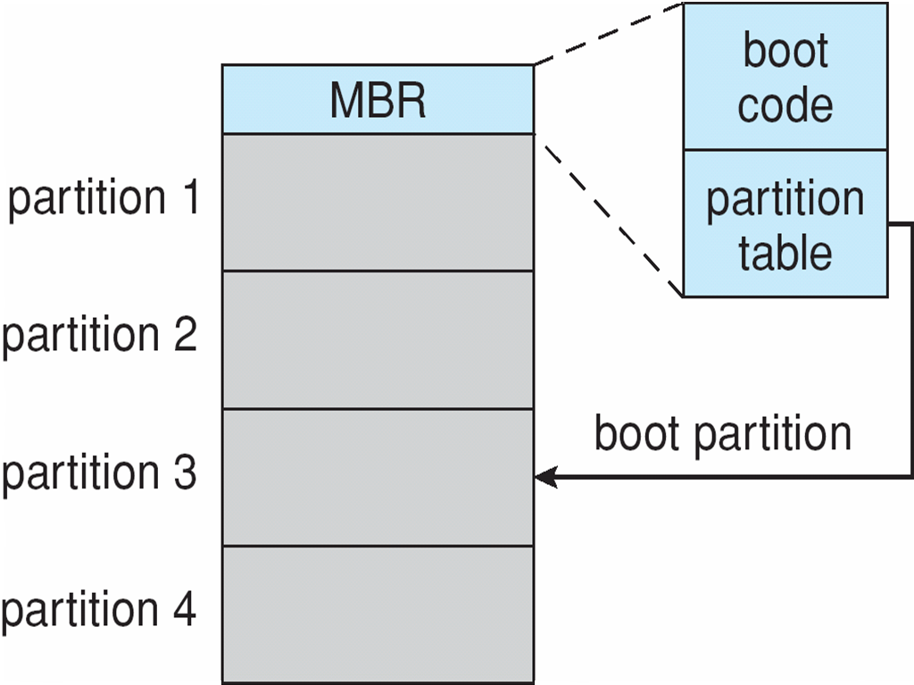
Device Storage Management (Cont.)
Boot block initializes system
系统的初始引导程序以固件形式存储在ROM(现代机器一般为Flash)中
Bootstrap loader 程序存放在启动分区的引导块
Booting from secondary storage in Windows

Slide 47
Bad Blocks
新磁盘就有可能已有坏块，但现代的磁盘在出厂检测时，磁盘内部就处理好了用备用块替代坏块的过程，称为扇区备用(sector sparing)或转寄(forwarding)
使用中坏块可能会增加，扇区偶尔会有很少的比特出错，可以通过ECC纠错码纠正，但误码多了，就无法纠正
有些文件系统在逻辑初始化时，可选实际读取每一个块，并将无法读取的块标记出来，不会再使用
绝大部分磁盘在格式化时为每个柱面保留了少量备用块，并保留了一个备用柱面，当坏块需要重新映射时，尽量使用同一柱面的备用块

Slide 48
12.6 Swap-Space Management(交换空间管理)
用于整个进程的交换 (swapping)，或者虚拟内存分页管理中的页面换出换入
操作系统提供了交换空间管理(swap space management)
二级存储速度比内存慢，因此优化性能非常重要
可以在多个设备上开辟多个交换空间，这可以降低单个I/O设备的负载
最好是有专用的交换设备
可以是生磁盘，也可以是文件系统中的交换文件(性能稍差，但管理方便)
Linux系统用于交换的数据结构见后页的图：

Slide 49
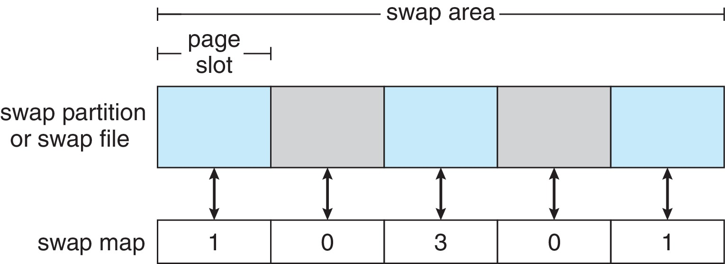
Swap-Space Management

Slide 50
12.7 RAID Structure(RAID结构)
RAID – redundant array of independent/inexpensive disks 磁盘冗余阵列
多个磁盘驱动器通过冗余(redundancy)，以较低的成本，提供大容量、快速、安全可靠的磁盘存储系统
RAID由两部分构成：磁盘阵列(一组可并行工作的磁盘)，及磁盘阵列管理软件
磁盘阵列管理软件把逻辑上连续的一组数据交叉分布存储在磁盘阵列中的各个磁盘上。好处：磁盘阵列管理软件可以并行处理对一组数据中的单个或多个数据的存取请求。
磁盘阵列管理软件还负责存储相关的校验信息。好处：当磁盘阵列中的某个磁盘发生故障时，磁盘阵列管理软件可以恢复存储在该磁盘上的数据。
磁盘阵列管理软件屏蔽了磁盘阵列的物理细节，使OS的其它成份不知道磁盘阵列的存在；在它们看来，系统中存在一个大容量的逻辑磁盘

Slide 51
RAID Structure(RAID结构)
如果磁盘阵列管理软件在主机系统中执行，则属软件实现的RAID
如果磁盘阵列管理软件在磁盘子系统中执行，则属硬件实现的RAID，相应的硬件称为RAID控制器或RAID卡。
采用RAID控制器方案的成本较高，但其效率高，不增加主机负担。此类RAID技术对主机完全透明，在主机看来，RAID就是一个容量大、速度快、可靠性高的磁盘。

Slide 52
RAID Structure(RAID结构)
多个磁盘时，至少一个磁盘出现故障的概率比单个磁盘高得多
但通过数据冗余，单个磁盘不会导致数据丢失(不包括RAID0)，只要在第二块(有的RAID同时2块盘损坏仍能恢复数据)磁盘损坏前，及时更换损坏的磁盘，就能完全恢复到完好的冗余状态
mean time to failure(平均失效时间) 失效前平均可正常工作时间
Mean time to repair(修补平均时间) – 若出现另一个故障会导致数据丢失的暴露时间
Mean time to data loss(数据丢失的平均时间) 取决于上述因素
对镜像磁盘，若其损坏假设为独立的，平均失效时间为100,000小时，而修补平均时间为10小时
数据丢失的平均时间为：100, 000² / (2 ∗ 10) = 500 ∗ 10⁶ 小时, 或57,000 年

Slide 53
RAID (Cont.)
我们介绍6个级别的RAID
RAID通过增加存储冗余数据来提高性能及可靠性
Mirroring(镜像) or shadowing (RAID 1) 中每个磁盘均有一个存储内容一样的另一个盘
Striped(分散) mirrors (RAID 1+0) or mirrored stripes (RAID 0+1) 提供了高性能及高可靠性
Block interleaved parity(块交织奇偶结构) (RAID 4, 5, 6) 仅增加少量(相对于镜像)的冗余存储
RAID仍存在失效的可能性，所以在不同阵列之间复制仍是常见的
常常将少量磁盘作为 hot-spare(热备份) 使用，平时不使用，当出现故障磁盘时，可自动替换故障盘，且RAID系统自动恢复数据，并重建冗余

Slide 54
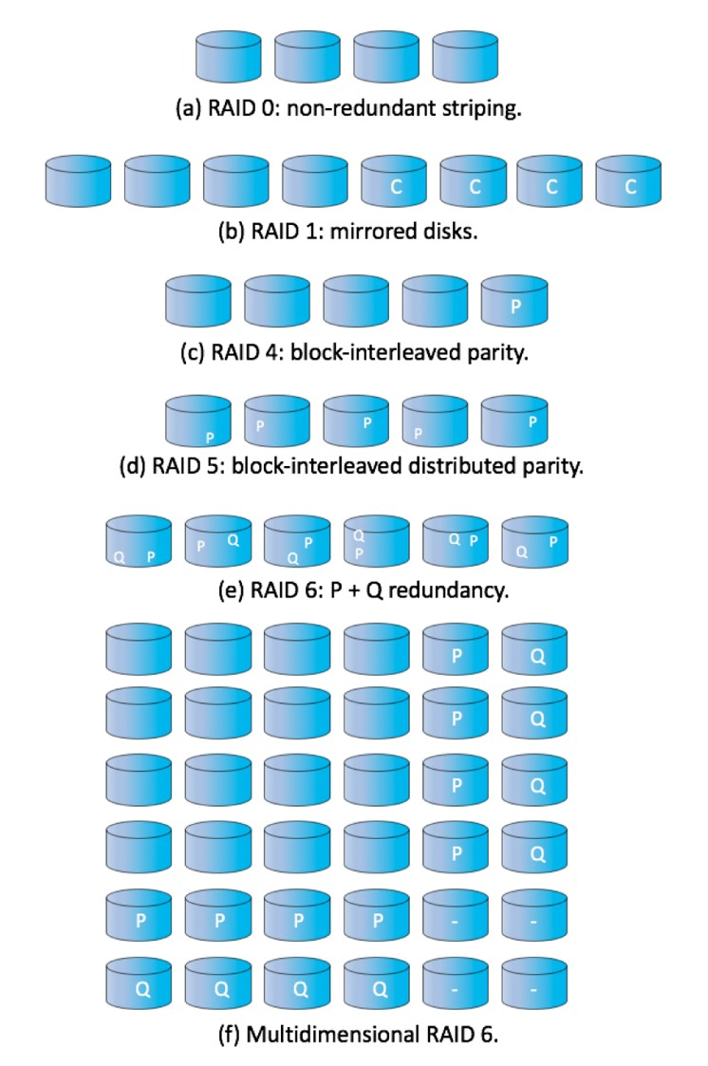
RAID Levels

Slide 55
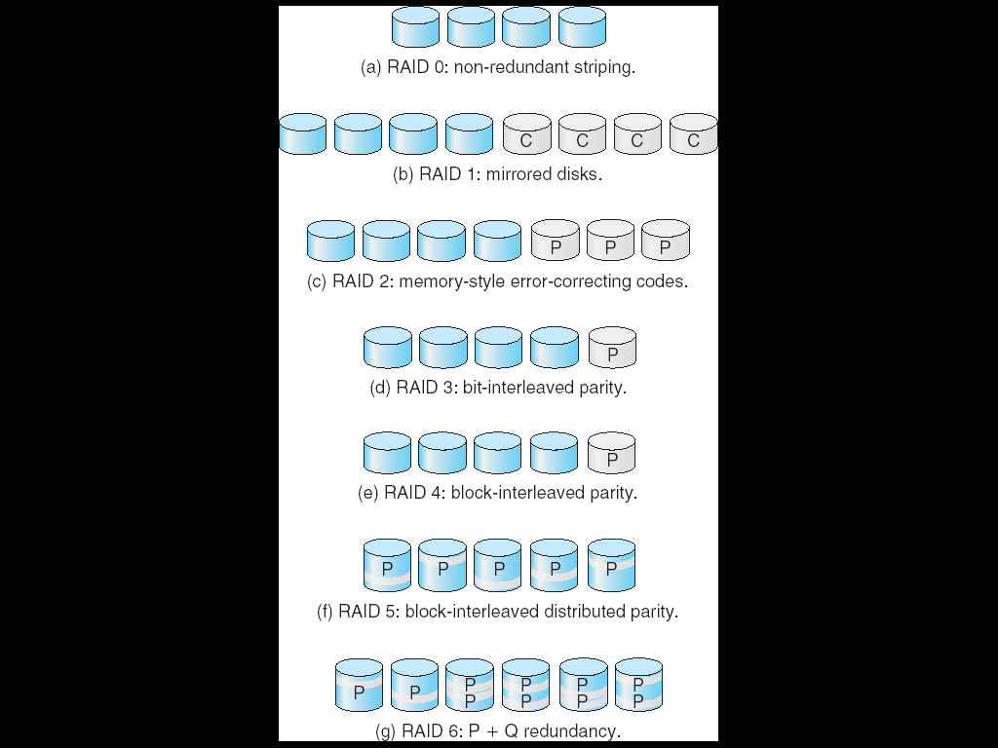
RAID Levels

Slide 56
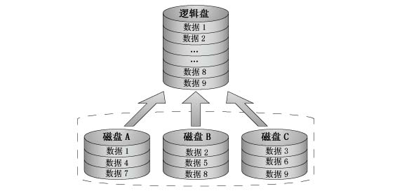
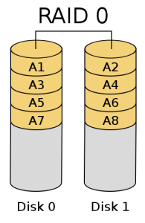
RAID0: non-redundant striping
非冗余块分条(分散，条带，striping)：
多个磁盘并行，可提高传输性能，但无容错能力(一个磁盘损坏，数据就丢失)

Slide 57
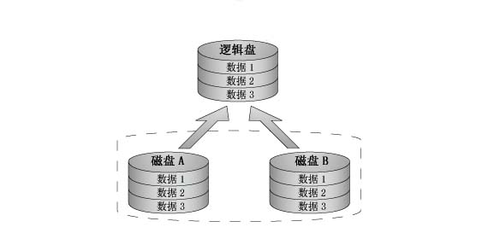
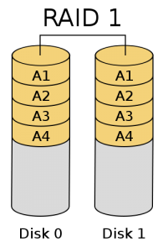
RAID1: mirrored disks
磁盘镜像：2N个磁盘，存储N个盘的内容，两两互为镜像。
单个磁盘的损坏，仍可回复数据。
数据冗余较大，空间利用率低。

Slide 58
RAID2: memory-style error-correcting codes
RAID2：内存方式的差错纠正(ECC，错误纠正吗)组织
ECC码不但能发现错误，还能纠正少量位数出错
RAID2将一个字节分散在多个磁盘上(比如4个或8个)，并增加冗余磁盘用于存储ECC码
单个磁盘的损坏后(包括存储ECC码的磁盘)，仍可恢复数据
需要的冗余磁盘数比镜像磁盘RAID1少
较少使用

Slide 59
RAID3: bit-interleaved parity
RAID3：位交织(交错)奇偶校验结构
RAID3将一个字节分散在多个磁盘上(比如4个或8个)，并增加冗余磁盘(比如1个或2个)用于存储奇偶校验码
与内存不同，单个磁盘的每个扇区具有自己检错纠错码，少量位出错会用纠错码纠正过来，较多的位出错通常能发现错误
因此我们知道一个带奇偶校验的字节中，哪个位不能读出了，通过其他位的奇偶性运算，即可恢复损坏的磁盘的内容
单个磁盘的损坏后(包括存储奇偶位的磁盘)，仍可恢复数据
需要的冗余磁盘数比镜像磁盘RAID1少

Slide 60
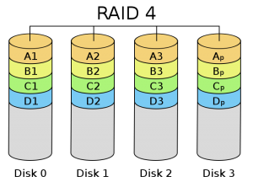
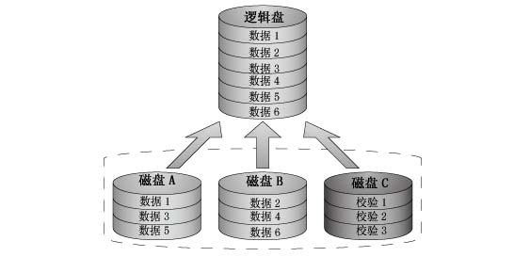
RAID4: block-interleaved parity
RAID4：块交织(交错)奇偶校验结构
多个磁盘按块分散存储(与RAID0类似)，并增加额外的磁盘用于存储奇偶校验信息。单个磁盘的损坏后(包括存储奇偶位的磁盘)，仍可恢复数据

Slide 61
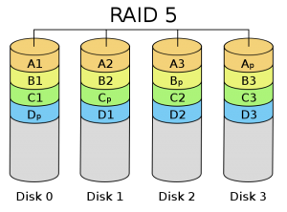
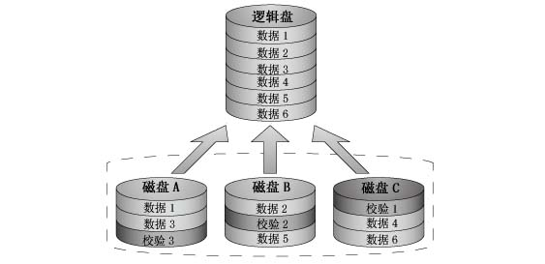
RAID5: block-interleaved distributed parity
RAID5：块交织(交错)分布奇偶结构
类似于RAID4，但将数据与奇偶位分布在所有N+1块磁盘上(RAID4将奇偶位存储在固定的磁盘上)。
避免对存储奇偶位磁盘的过度使用

Slide 62
RAID6: P + Q redundancy scheme
RAID6：P + Q 冗余方案
与RAID5类似，但保存了额外的冗余信息，以防范多个磁盘故障
除了使用奇偶校验码，可以使用差错纠正码

Slide 63
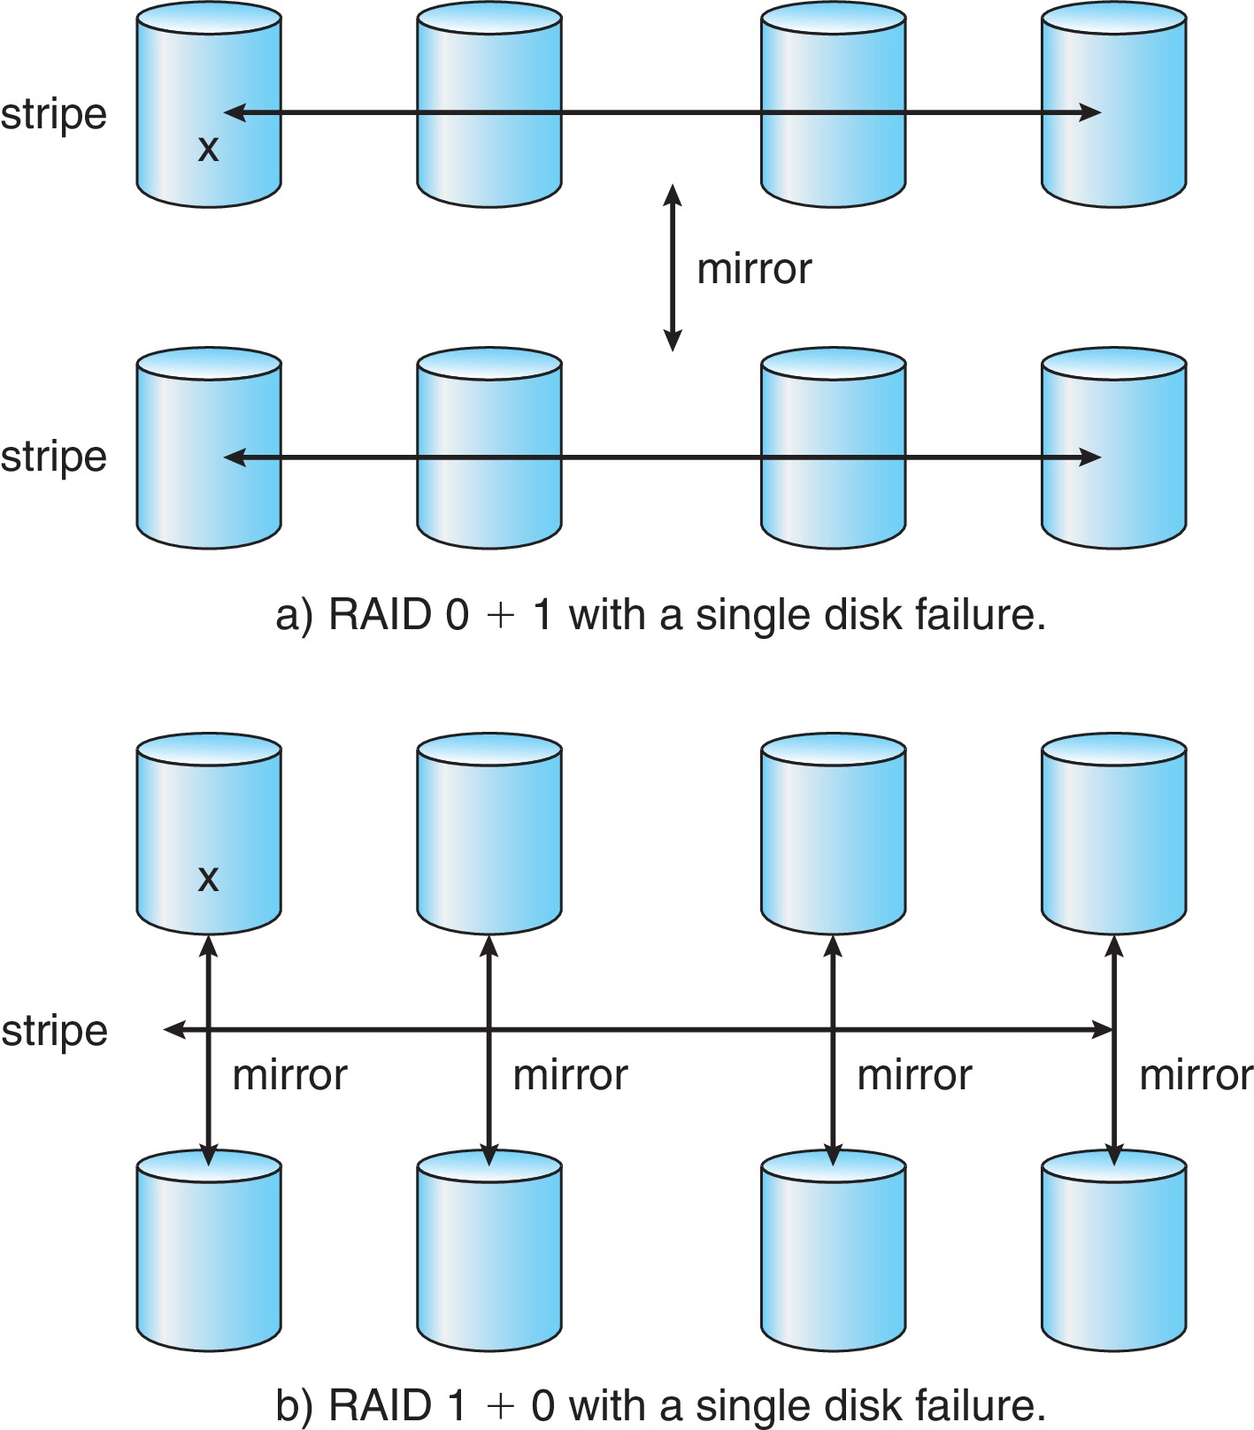
RAID (0 + 1) and (1 + 0)

Slide 64
RAID方案的选择
数据重构
RAID 0无法重构(无冗余，无容错)
RAID 1重构容易
其它级别需要读入所有阵列中的其它磁盘才能重构
应用背景
RAID 0－适于性能要求高但数据可靠性要求不高的应用；
RAID 1－适于可靠性要求高和快速恢复的应用；
RAID (0+1) 和 (1+0)－适于性能和可靠性要求都高的应用；例如小型数据库服务器；
RAID 5－用于存储量大的数据；
RAID 6－较少有支持

Slide 65
*Other Features
Regardless of where RAID implemented, other useful features can be added
Snapshot is a view of file system before a set of changes take place (i.e. at a point in time)
More in Ch 12
Replication is automatic duplication of writes between separate sites
For redundancy and disaster recovery
Can be synchronous or asynchronous
Hot spare disk is unused, automatically used by RAID production if a disk fails to replace the failed disk and rebuild the RAID set if possible
Decreases mean time to repair

Slide 66
*Extensions
RAID alone does not prevent or detect data corruption or other errors, just disk failures
Solaris ZFS adds checksums of all data and metadata
Checksums kept with pointer to object, to detect if object is the right one and whether it changed
Can detect and correct data and metadata corruption
ZFS also removes volumes, partitions
Disks allocated in pools
Filesystems with a pool share that pool, use and release space like malloc() and free() memory allocate / release calls
ZFS checksums all metadata and data

Slide 67
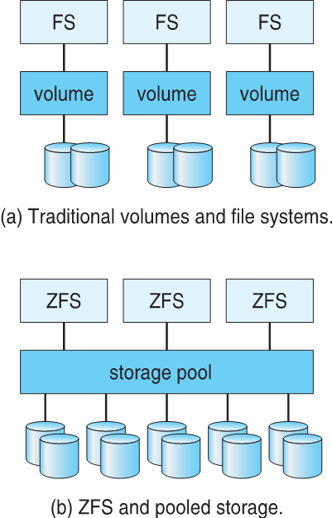
*Traditional and Pooled Storage

Slide 68
*12.8 Stable-Storage Implementation
稳定存储实现
Write-ahead log scheme requires stable storage.
To implement stable storage:
Replicate information on more than one nonvolatile storage media with independent failure modes.
Update information in a controlled manner to ensure that we can recover the stable data after any failure during data transfer or recovery.

Slide 69
*12.9 Tertiary Storage Devices(三级存储结构)
Low cost is the defining characteristic of tertiary storage.
Generally, tertiary storage is built using removable media
Common examples of removable media are floppy disks and CD-ROMs; other types are available.

Slide 70
Removable Disks
Floppy disk — thin flexible disk coated with magnetic material, enclosed in a protective plastic case.
Most floppies hold about 1 MB; similar technology is used for removable disks that hold more than 1 GB.
Removable magnetic disks can be nearly as fast as hard disks, but they are at a greater risk of damage from exposure.

Slide 71
Removable Disks (Cont.)
A magneto-optic disk records data on a rigid platter coated with magnetic material.
Laser heat is used to amplify a large, weak magnetic field to record a bit.
Laser light is also used to read data (Kerr effect).
The magneto-optic head flies much farther from the disk surface than a magnetic disk head, and the magnetic material is covered with a protective layer of plastic or glass; resistant to head crashes.
Optical disks do not use magnetism; they employ special materials that are altered by laser light.

Slide 72
WORM Disks
The data on read-write disks can be modified over and over.
WORM (“Write Once, Read Many Times”) disks can be written only once.
Thin aluminum film sandwiched between two glass or plastic platters.
To write a bit, the drive uses a laser light to burn a small hole through the aluminum; information can be destroyed by not altered.
Very durable and reliable.
Read Only disks, such ad CD-ROM and DVD, com from the factory with the data pre-recorded.

Slide 73
Tapes
Compared to a disk, a tape is less expensive and holds more data, but random access is much slower.
Tape is an economical medium for purposes that do not require fast random access, e.g., backup copies of disk data, holding huge volumes of data.
Large tape installations typically use robotic tape changers that move tapes between tape drives and storage slots in a tape library.
stacker – library that holds a few tapes
silo – library that holds thousands of tapes
A disk-resident file can be archived to tape for low cost storage; the computer can stage it back into disk storage for active use.

Slide 74
Operating System Issues
Major OS jobs are to manage physical devices and to present a virtual machine abstraction to applications
For hard disks, the OS provides two abstraction:
Raw device – an array of data blocks.
File system – the OS queues and schedules the interleaved requests from several applications.

Slide 75
Application Interface
Most OSs handle removable disks almost exactly like fixed disks — a new cartridge is formatted and an empty file system is generated on the disk.
Tapes are presented as a raw storage medium, i.e., and application does not not open a file on the tape, it opens the whole tape drive as a raw device.
Usually the tape drive is reserved for the exclusive use of that application.
Since the OS does not provide file system services, the application must decide how to use the array of blocks.
Since every application makes up its own rules for how to organize a tape, a tape full of data can generally only be used by the program that created it.

Slide 76
Tape Drives
The basic operations for a tape drive differ from those of a disk drive.
locate positions the tape to a specific logical block, not an entire track (corresponds to seek).
The read position operation returns the logical block number where the tape head is.
The space operation enables relative motion.
Tape drives are “append-only” devices; updating a block in the middle of the tape also effectively erases everything beyond that block.
An EOT mark is placed after a block that is written.

Slide 77
File Naming
The issue of naming files on removable media is especially difficult when we want to write data on a removable cartridge on one computer, and then use the cartridge in another computer.
Contemporary OSs generally leave the name space problem unsolved for removable media, and depend on applications and users to figure out how to access and interpret the data.
Some kinds of removable media (e.g., CDs) are so well standardized that all computers use them the same way.

Slide 78
Hierarchical Storage Management (HSM)
A hierarchical storage system extends the storage hierarchy beyond primary memory and secondary storage to incorporate tertiary storage — usually implemented as a jukebox of tapes or removable disks.
Usually incorporate tertiary storage by extending the file system.
Small and frequently used files remain on disk.
Large, old, inactive files are archived to the jukebox.
HSM is usually found in supercomputing centers and other large installations that have enormous volumes of data.

Slide 79
Speed
Two aspects of speed in tertiary storage are bandwidth and latency.
Bandwidth is measured in bytes per second.
Sustained bandwidth – average data rate during a large transfer; # of bytes/transfer time. Data rate when the data stream is actually flowing.
Effective bandwidth – average over the entire I/O time, including seek or locate, and cartridge switching. Drive’s overall data rate.

Slide 80
Speed (Cont.)
Access latency – amount of time needed to locate data.
Access time for a disk – move the arm to the selected cylinder and wait for the rotational latency; < 35 milliseconds.
Access on tape requires winding the tape reels until the selected block reaches the tape head; tens or hundreds of seconds.
Generally say that random access within a tape cartridge is about a thousand times slower than random access on disk.
The low cost of tertiary storage is a result of having many cheap cartridges share a few expensive drives.
A removable library is best devoted to the storage of infrequently used data, because the library can only satisfy a relatively small number of I/O requests per hour.

Slide 81
Reliability
A fixed disk drive is likely to be more reliable than a removable disk or tape drive.
An optical cartridge is likely to be more reliable than a magnetic disk or tape.
A head crash in a fixed hard disk generally destroys the data, whereas the failure of a tape drive or optical disk drive often leaves the data cartridge unharmed.

Slide 82
Cost
Main memory is much more expensive than disk storage
The cost per megabyte of hard disk storage is competitive with magnetic tape if only one tape is used per drive.
The cheapest tape drives and the cheapest disk drives have had about the same storage capacity over the years.
Tertiary storage gives a cost savings only when the number of cartridges is considerably larger than the number of drives.

Slide 83
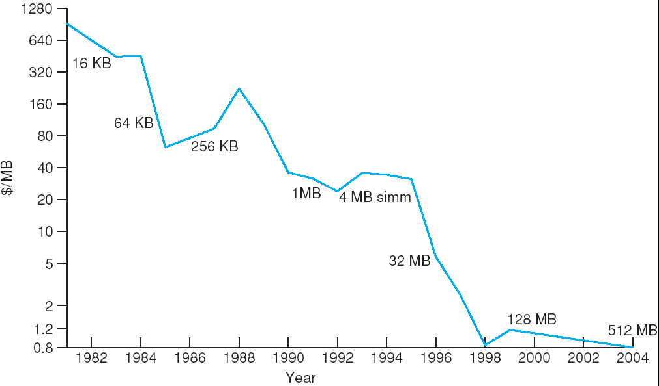
Price per Megabyte of DRAM, From 1981 to 2004

Slide 84
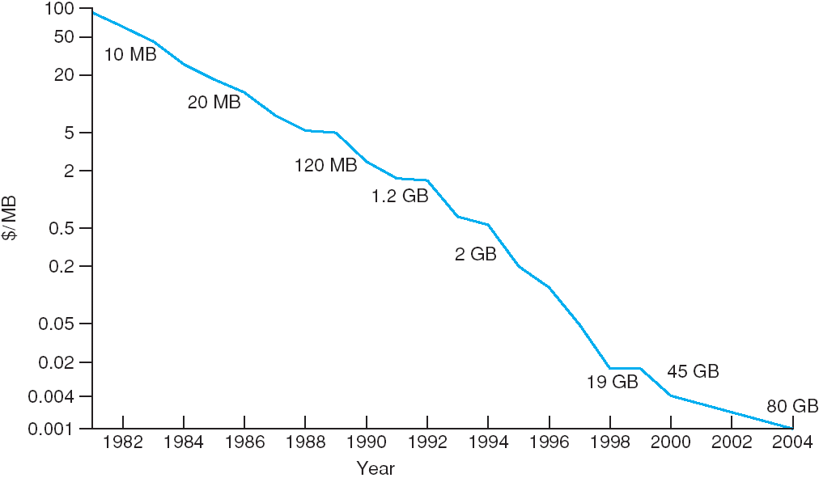
Price per Megabyte of Magnetic Hard Disk, From 1981 to 2004

Slide 85
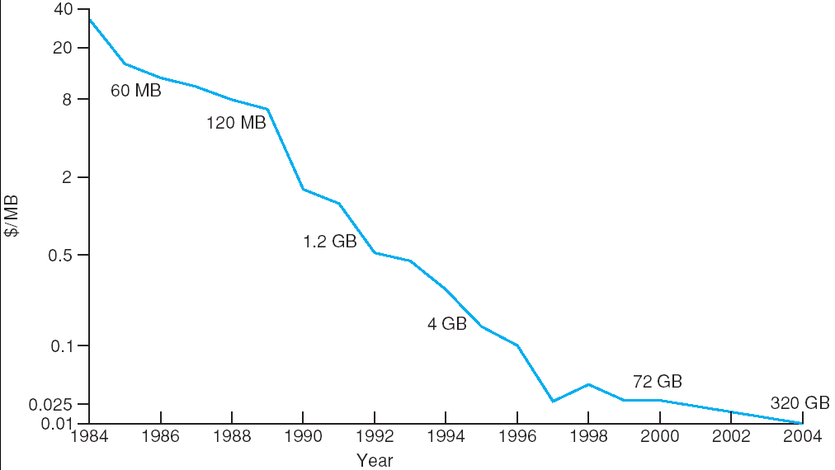
Price per Megabyte of a Tape Drive, From 1984-2000

Slide 86
Summary 1/4
Hard disk drives and nonvolatile memory devices are the major secondary storage I/O units on most computers. Modern secondary storage is structured as large one-dimensional arrays of logical blocks.
Drives of either type may be attached to a computer system in one of three ways: (1) through the local I/O ports on the host computer, (2) directly connected to motherboards, or (3) through a communications network or storage network connection.
Requests for secondary storage I/O are generated by the file system and by the virtual memory system. Each request specifies the address on the device to be referenced in the form of a logical block number

Slide 87
Summary 2/4
Disk-scheduling algorithms can improve the effective bandwidth of HDDs, the average response time, and the variance in response time. Algorithms such as SCAN and C-SCAN are designed to make such improvements through strategies for disk-queue ordering. Performance of disk scheduling algorithms can vary greatly on hard disks. In contrast, because solid-state disks have no moving parts, performance varies little among scheduling algorithms, and quite often a simple FCFS strategy is used
Storage devices are partitioned into one or more chunks of space. Each partition can hold a volume or be part of a multidevice volume. File systems are created in volumes

Slide 88
Summary 3/4
The operating system manages the storage device’s blocks. New devices typically come pre-formatted. The device is partitioned, file systems are created, and boot blocks are allocated to store the system’s bootstrap program if the device will contain an operating system. Finally, when a block or page is corrupted, the system must have a way to lock out that block or to replace it logically with a spare
An efficient swap space is a key to good performance in some systems. Some systems dedicate a raw partition to swap space, and others use a file within the file system instead. Still other systems allow the user or system administrator to make the decision by providing both options

Slide 89
Summary 4/4
Because of the amount of storage required on large systems, and because storage devices fail in various ways, secondary storage devices are frequently made redundant via RAID algorithms. These algorithms allow more than one drive to be used for a given operation and allow continued operation and even automatic recovery in the face of a drive failure. RAID algorithms are organized into different levels; each level provides some combination of reliability and high transfer rates

Slide 90
End of Chapter 12: Mass-Storage Systems

